Slide 1


Unlocking Synergy: PowerBI and PowerApps Collaboration for Data-Driven Decision-Making
Sascha Götz, scieneers GmbH

Slide 2
Departure
Unlocking Synergy: PowerBI and PowerApps Collaboration for Data-Driven Decision-Making
Create a flight plan
Prepare datamodel
Sascha Götz, scieneers GmbH
Build the app
Demo

Slide 3

Create a flight plan
Departure
“Use a mixed model in PowerBI, have the table you want to edit in direct query mode”
Create a flight plan
Prepare datamodel
Build the app
Demo

Slide 4
Create a flight plan
“Use a mixed model in PowerBI, have the table you want to edit in direct query mode”
Departure
“Create the powerapp from within powerbi desktop initially, otherwise it will not have a PowerBI Integration”
Create a flight plan
Prepare datamodel
Build the app
Demo

Slide 5
Create a flight plan
“Use a mixed model in PowerBI, have the table you want to edit in direct query mode”
“Create the powerapp from within powerbi desktop initially, otherwise it will not have a PowerBI Integration”
Departure
“Use the PowerBI Integration. Refresh visuals using PowerBIIntegration.Refresh()””
Create a flight plan
Prepare datamodel
Build the app
Demo

Slide 6
Create a flight plan
“Use a mixed model in PowerBI, have the table you want to edit in direct query mode”
“Create the powerapp from within powerbi desktop initially, otherwise it will not have a PowerBI Integration”
Departure
“However, PowerBI Integration only works when deployed to PowerBI Service, not in PBI Desktop”
Create a flight plan
“Use the PowerBI Integration. Refresh visuals using PowerBIIntegration.Refresh()””
Prepare datamodel
Build the app
Demo

Slide 7
Create a flight plan
“Use a mixed model in PowerBI, have the table you want to edit in direct query mode”
“Create the powerapp from within powerbi desktop initially, otherwise it will not have a PowerBI Integration”
Departure
Create a flight plan
“Use the PowerBI Integration. Refresh visuals using PowerBIIntegration.Refresh()””
“However, PowerBI Integration only works when deployed to PowerBI Service, not in PBI Desktop”
Prepare datamodel
Build the app
Demo

Slide 8
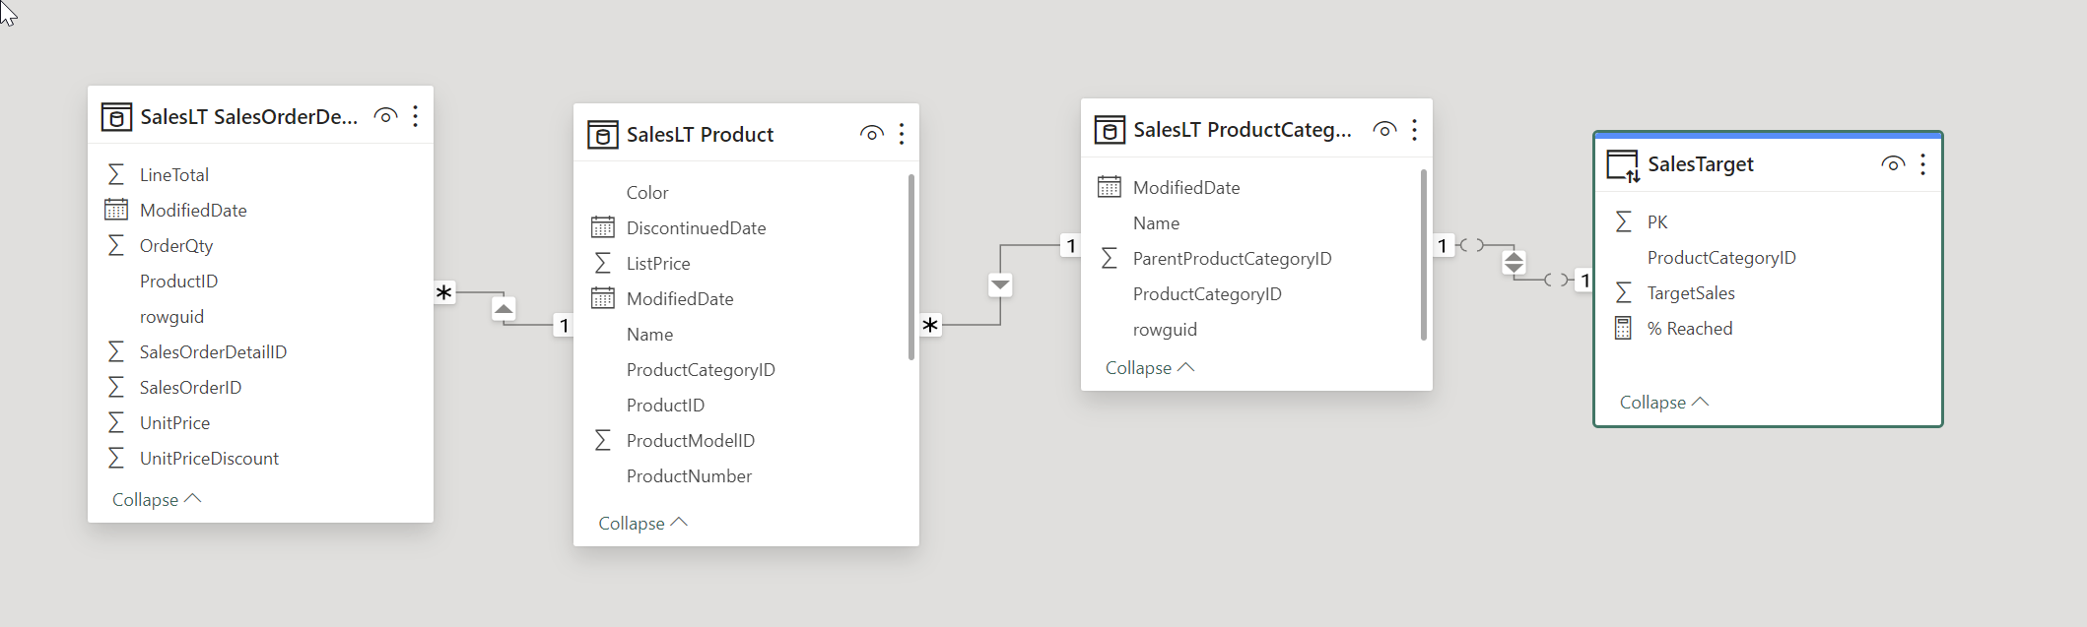

Prepare datamodel
Departure
Create a flight plan
“Import your data as usually, add a new table in direct query mode to hold KPI targets”
Prepare datamodel
Build the app
Demo

Slide 9
Prepare datamodel
Departure
Create a flight plan
“Make sure that your KPI target table has a primary key, otherwise PowerAps will not be able to update it”
Prepare datamodel
“Import your data as usually, add a new table in direct query mode to hold KPI targets”
Build the app
Demo

Slide 10
Prepare datamodel
Departure
Create a flight plan
Prepare datamodel
“Import your data as usually, add a new table in direct query mode to hold KPI targets”
“Make sure that your KPI target table has a primary key, otherwise PowerAps will not be able to update it”
Build the app
Demo

Slide 11
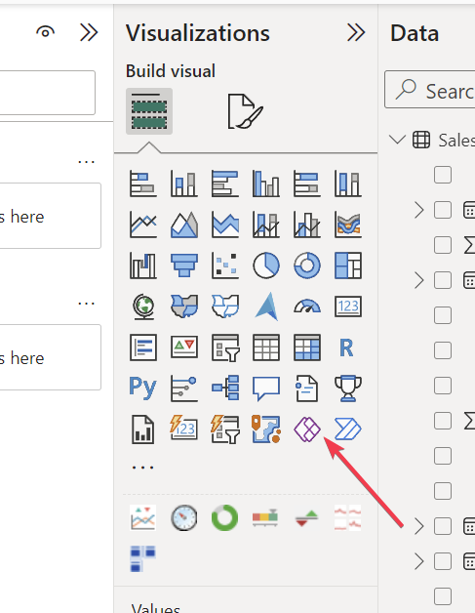

Build the app
Create a new PowerApps Visual
Departure
Create a flight plan
Prepare datamodel
Build the app
Demo

Slide 12
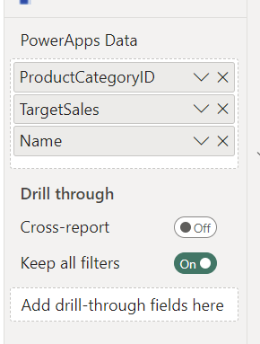
Build the app
Create a new PowerApps Visual
Add Fields you want to show/edit to visual
Departure
Create a flight plan
Prepare datamodel
Build the app
Demo

Slide 13
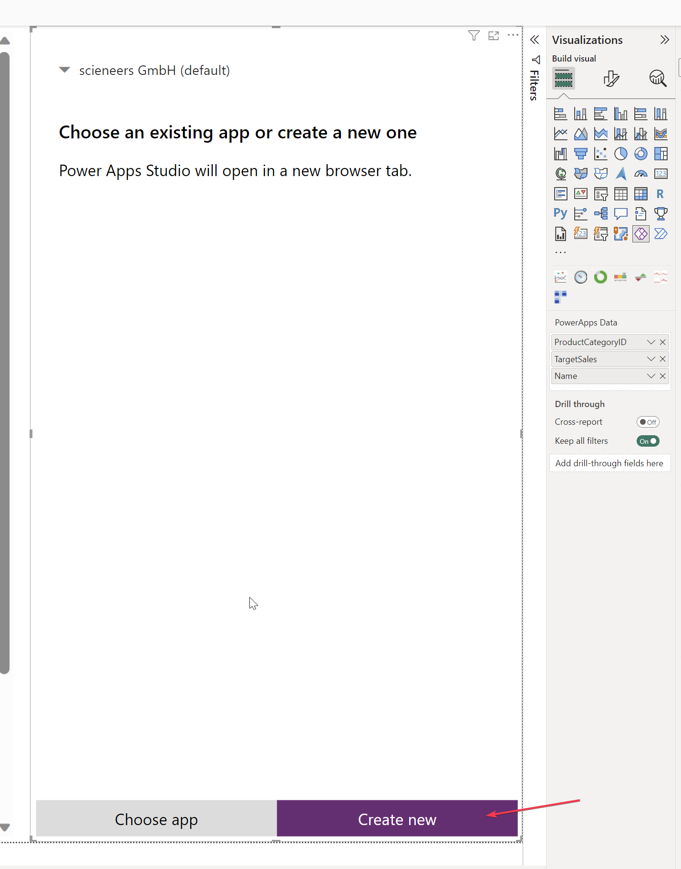
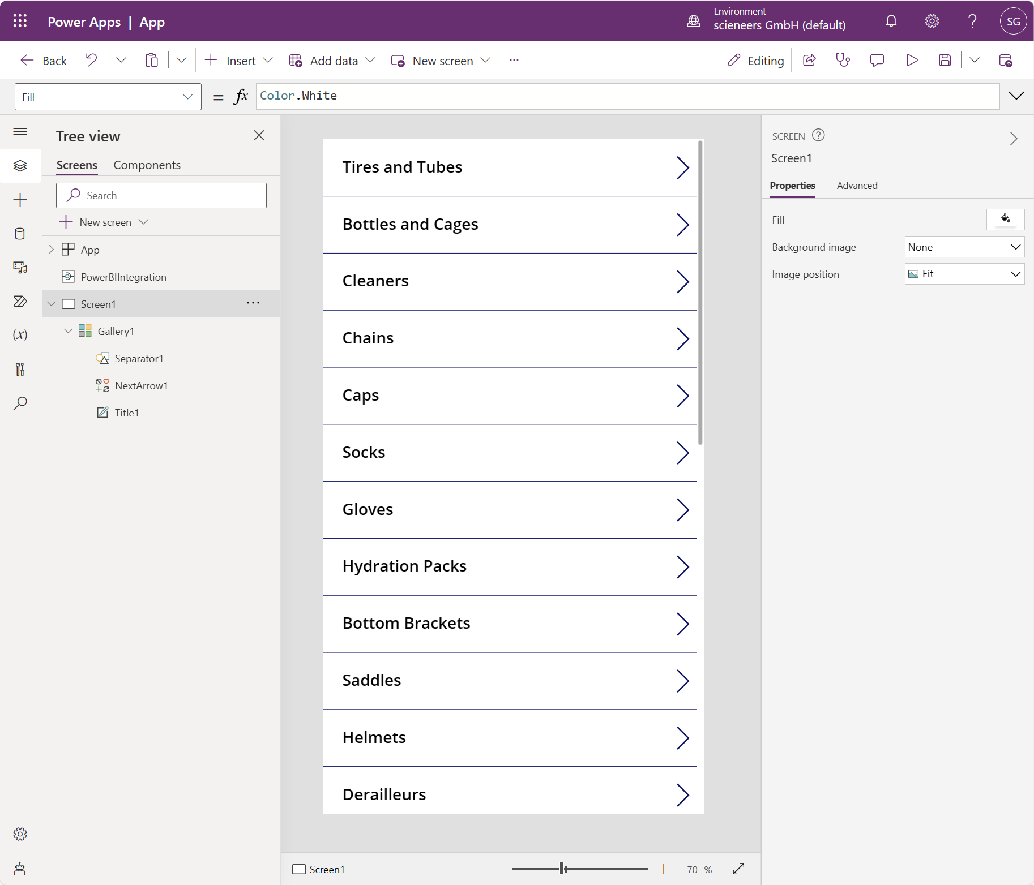
Build the app
Select “Create new”
PowerApps editor will start
Departure
Create a flight plan
Prepare datamodel
Build the app
Demo

Slide 14
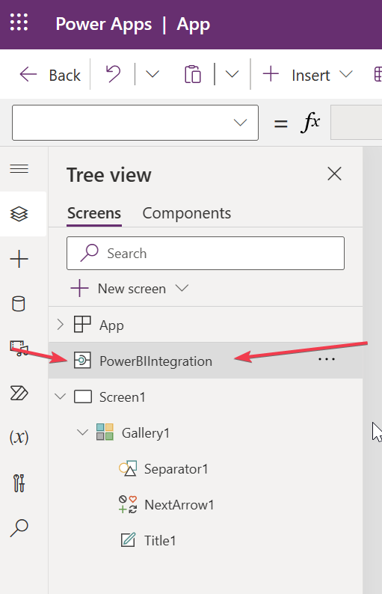
Build the app
Make sure, that
PowerBIIntegration is included
Departure
Create a flight plan
Prepare datamodel
Build the app
Demo

Slide 15
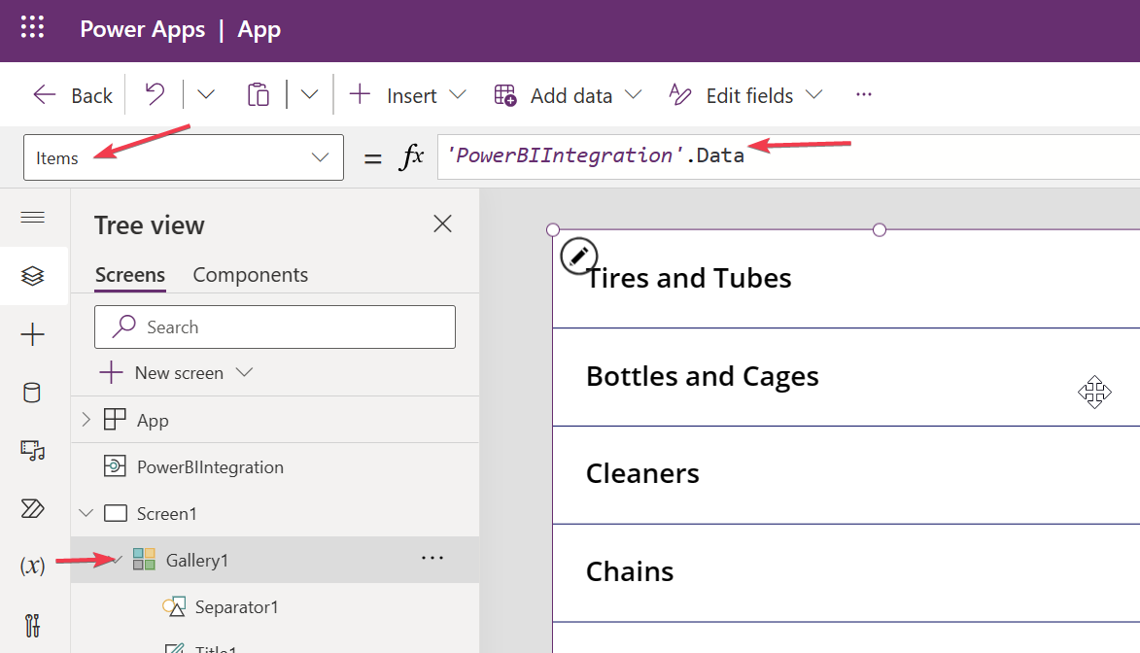
Build the app
Make sure, that
PowerBIIntegration is included
Create a flight plan
Prepare datamodel
Select “Gallery1”
Data is being pulled from PowerBI
through the PowerBIIntegration
Build the app
Demo

Slide 16
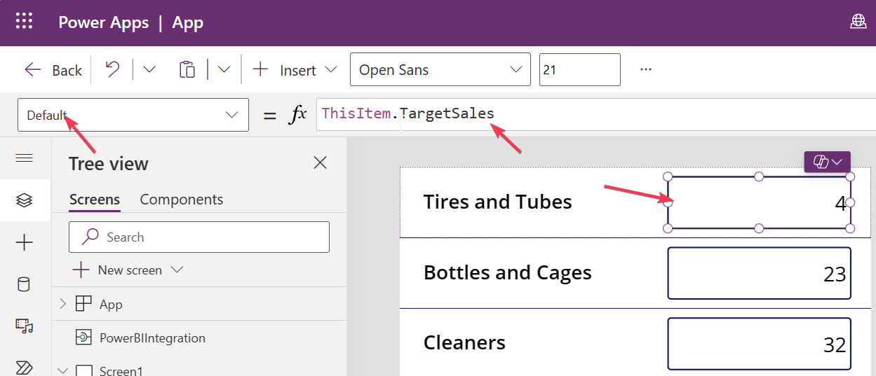
Build the app
Add a new TextInput to the Gallery and update the “Default”-property to use the TargetSales value
Departure
Create a flight plan
Prepare datamodel
Build the app
Demo

Slide 17
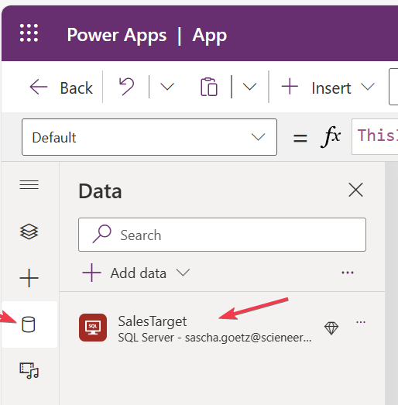
Build the app
Using the PowerBIIntegration, it is not possible to directly update a table. Therefore we will add the table as a data source in PowerApps.
Create a flight plan
Prepare datamodel
Build the app
Demo

Slide 18
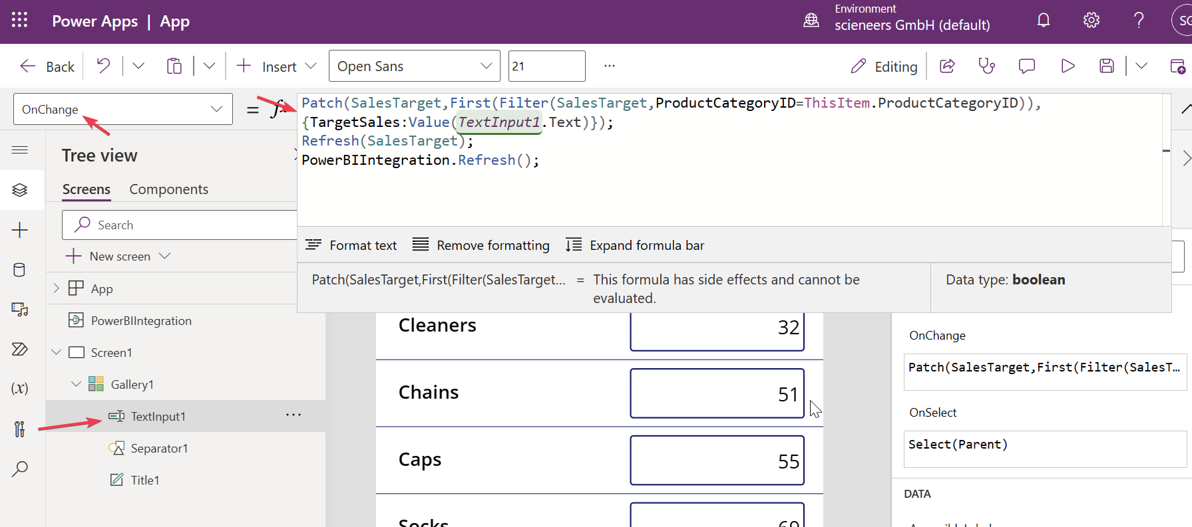
Build the app
Update the “OnChange”-Event of the TextInput to update the respective Field, then use PowerBI Integration to refresh visuals in PBI.
Departure
Create a flight plan
Prepare datamodel
Build the app
Demo

Slide 19
Build the app
Deploy to PowerBI Service and try it!
Departure
Create a flight plan
Prepare datamodel
Build the app
Demo

Slide 20

Demo
Departure
Create a flight plan
Prepare datamodel
Build the app
Demo

Slide 21
Questions?

